Slide 1
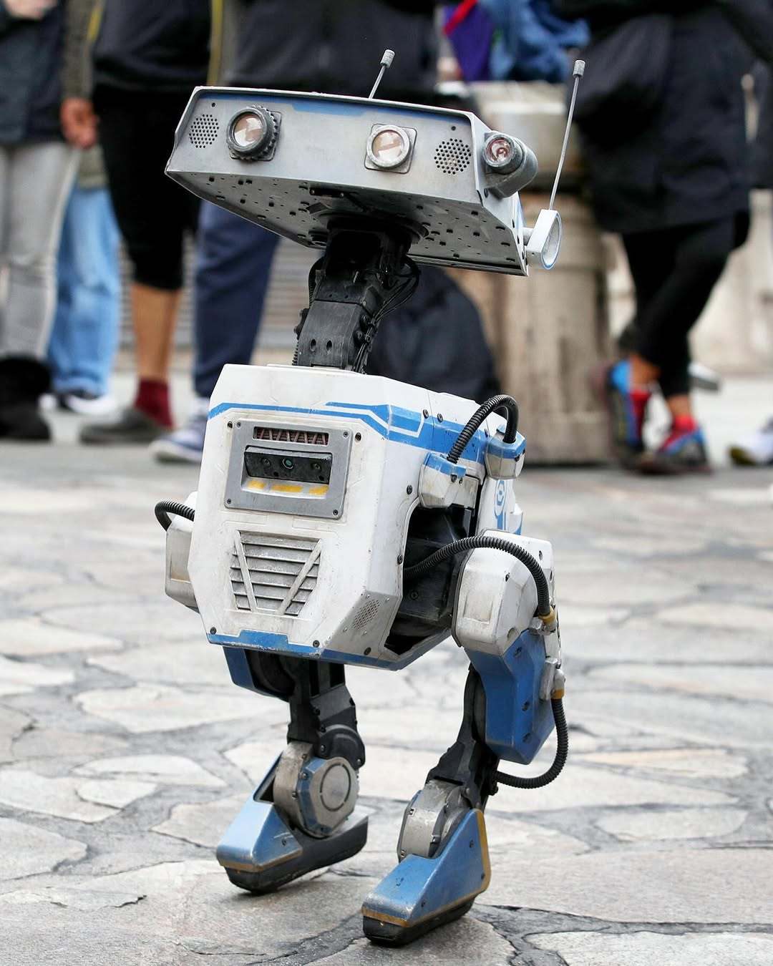


Duck march
Project: Happy feet
A C Anirudh - RAE23003
Nihal Paleti - RAE23029
S Venkata Rami Reddy - RAE23038

Slide 2
Motivation & Background
• Inefficient and Over-engineered Humanoids for Home-Assistance
• The gap between research and implementation of Robots in daily life is still large
• Limited application of HRI and IoT tuned for Elders at home

Slide 3
Problem Statement
• There is a gap between technologically complex robots and emotionally engaging companions that are affordable and sustainable
• Simple household with ample lighting and network with no hazard for Robot
• Elderly and assistance-requiring citizens who live alone/isolated

Slide 4

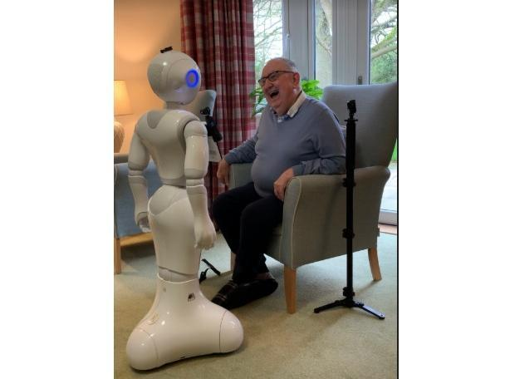
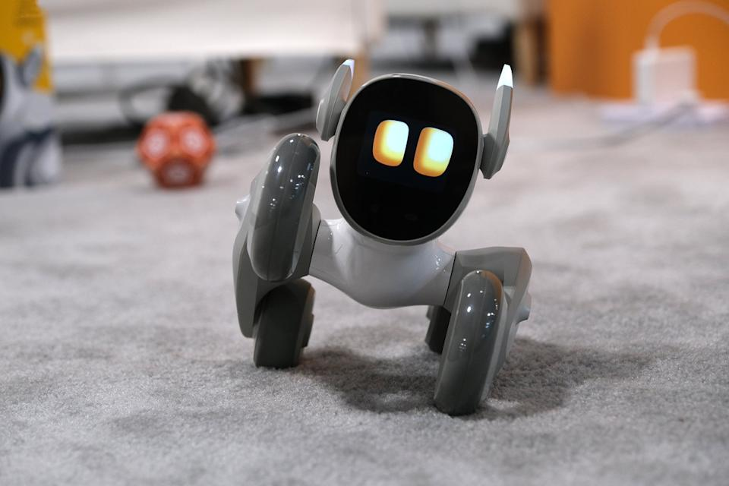
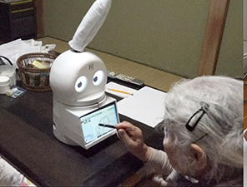
User Need Analysis
• Trusting and depend on robot
• Provide companionship.
• To be Handled with care and safety
Notes:
Reliable, Companions, Safe

Slide 5
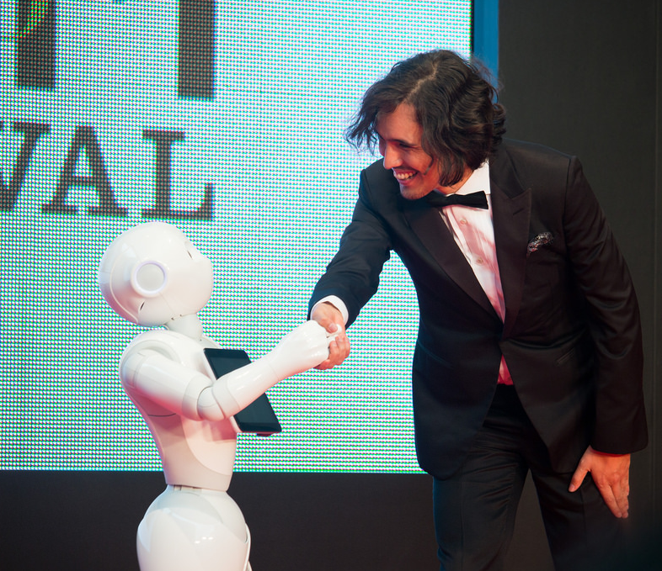

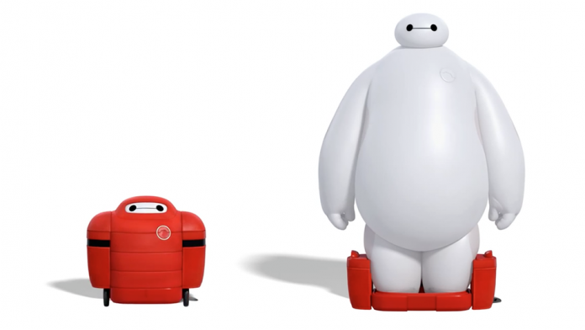
Proposed Solution Overview
• Robust Control
• Communicates using AI, and using VLA
• Soft and Flexible design
Notes:
Robust Control, VLA and AI, Soft and Flexible

Slide 6

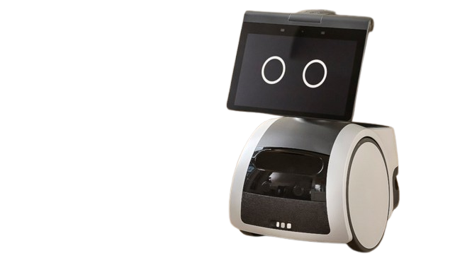
Concept Generation
Concept A
Wheeled Mobile Companion
Wheeled base for indoor navigation
Mobile environmental sensing
Basic expressive head or screen
Notes:
Pros
Mechanically stable
Energy efficient
Proven navigation platforms
Cons
Appliance-like appearance
Less pet-like behavior
Wheels reduce emotional engagement

Slide 7
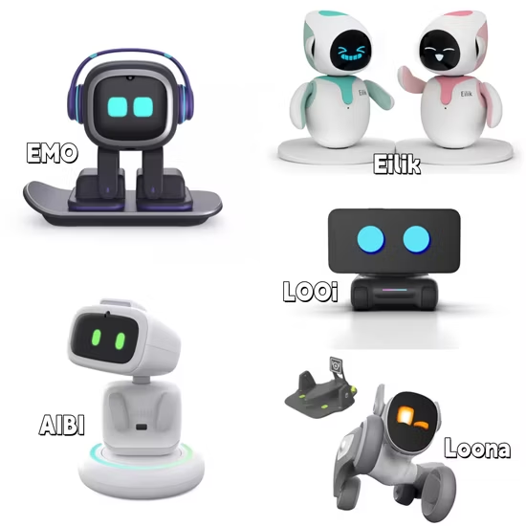
Concept Generation
Concept B
Static Companion Node
Stationary robot placed in a fixed location
Expressive eyes and basic interaction
Environmental sensors + CV from one viewpoint
Notes:
Pros
Simple mechanics
High reliability
Low power consumption
Cons
Limited situational awareness
No room-to-room context
Reduced companionship feel

Slide 8
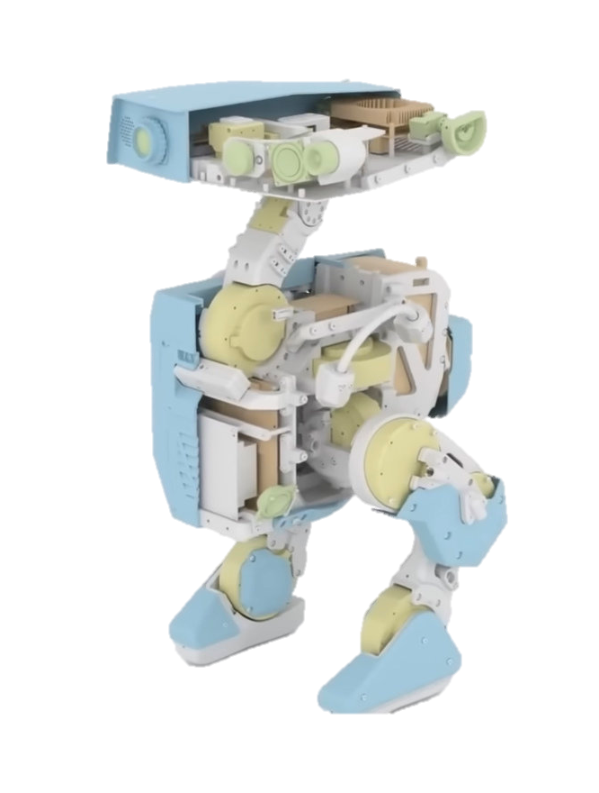
Concept Generation
Concept C
Bipedal Pet-Like Companion
Duck-inspired biped legs for slow, stable motion
Box-like torso for modular sensing
Expressive eyes for companionship
Mobile environmental and presence awareness
Notes:
Pros
Strong emotional acceptance
Clear companion identity
Room-level context awareness
Supports interaction + monitoring
Cons
Higher control complexity
Slower movement
Requires careful balance design

Slide 9
Concept Selection Matrix
Criteria | Concept A | Concept B | Concept C
C1 – Feasibility | 4 | 5 | 4
C2 – Cost | 4 | 5 | 3
C3 – Complexity | 3 | 5 | 3
C4 – Impact | 4 | 3 | 5
C5 – Innovation | 3 | 2 | 5
Total Score | 18 | 20 | 20
Concept 3 is selected as it best balances emotional companionship, context-aware monitoring, and research depth, while remaining within non-medical and non-invasive boundaries.
Notes:
Justification
Strong emotional acceptance for elderly users
Mobile, room-level environmental awareness
Supports expressive interaction alongside monitoring
Higher design complexity justified by higher research value
Acknowledged Trade-offs
Increased control and balance challenges
Slower movement compared to wheeled designs
Requires careful safety-oriented behavior design

Slide 10
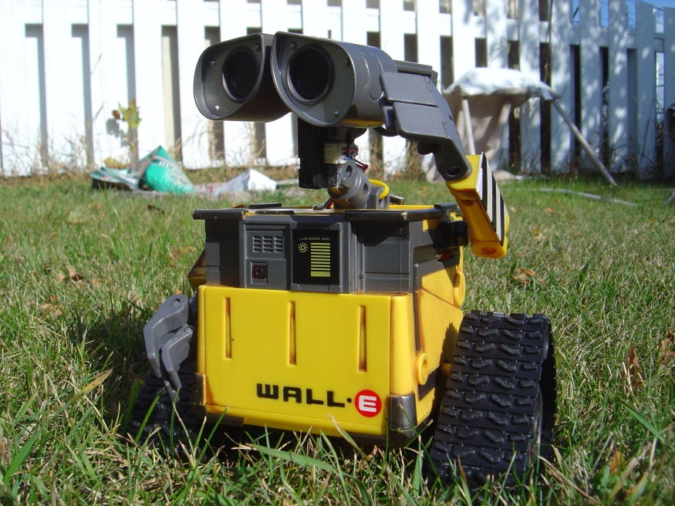
Functional Decomposition
The Main Function
Provide friendly, non-invasive indoor assistance and awareness for elderly individuals living alone
Acts as a companion and observer, supporting caregiver
It is not a medical or physical assistance system

Slide 11
Functional Decomposition
The Sub Functions
1. Interaction & Companionship
Expressive eye and head movements
Sound and touch-based responses
Pet-like idle and attention behaviors
2. Environmental Awareness
Gas leakage detection
Temperature & humidity monitoring
Ambient light sensing
3. Presence & Activity Observation
Person presence detection (CV)
Basic posture & room occupancy
Movement-based routine awareness
4. Communication & Integration
Caregiver alerts (event-based)
Home IoT interaction (lights, status)

Slide 12
Functional Decomposition
What the robot MUST do
Monitor environment and presence
Behave predictably and calmly
Report abnormal conditions
Maintain user-friendly interaction
System Responsibilites
Failure behavior
Stop movement
Neutral expression
Notify caregiver
Await instruction
What the robot WILL NOT do
Medical diagnosis or intervention
Continuous surveillance or recording
Physical assistance or load bearing
Autonomous emergency decisions

Slide 13
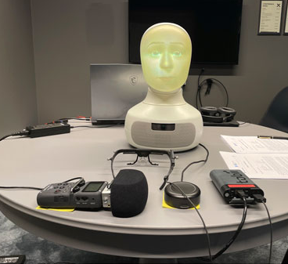
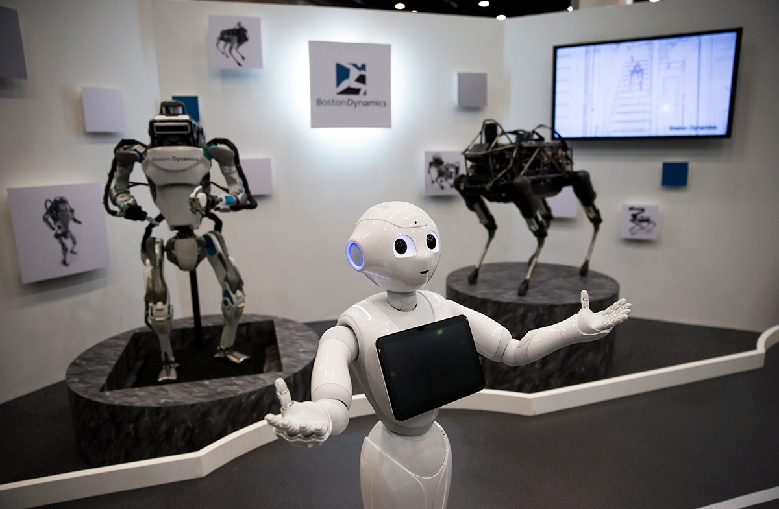
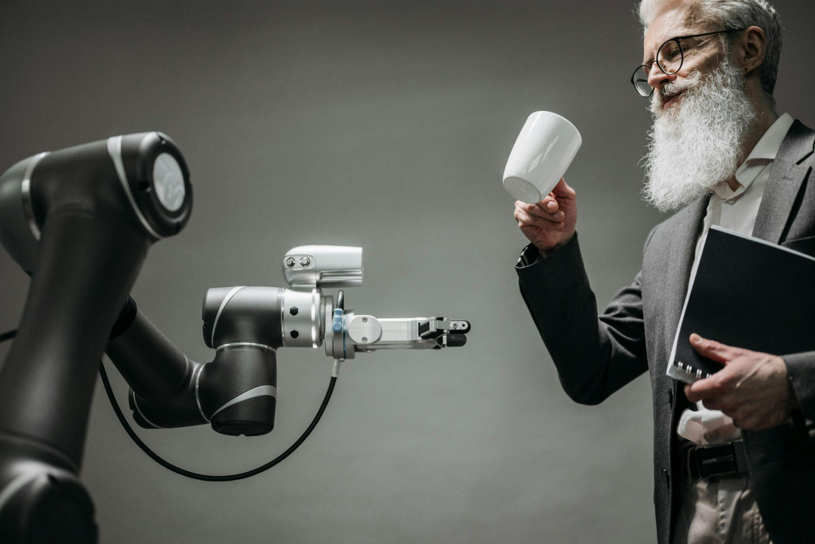
Robotics Relevance
• Camera, Voice, and IoT Sensors
DRL, HRI and CV
• VLA and IoT

Slide 14
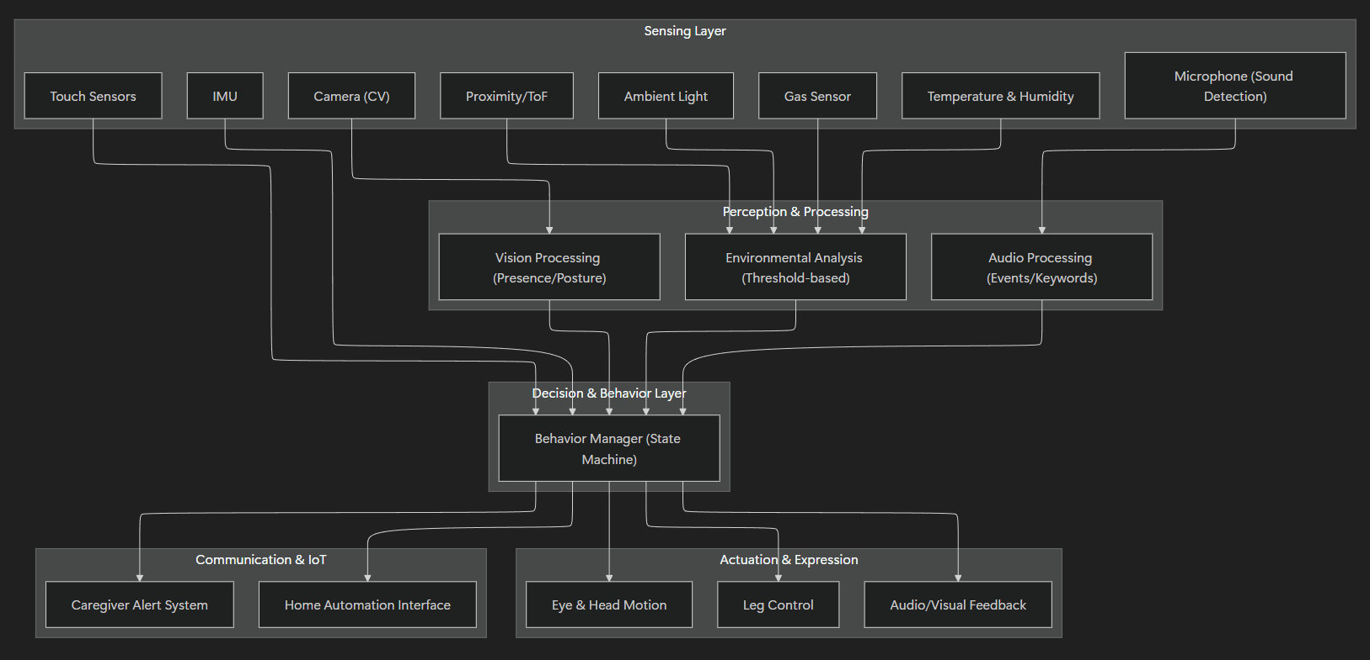
System Architecture

Slide 15
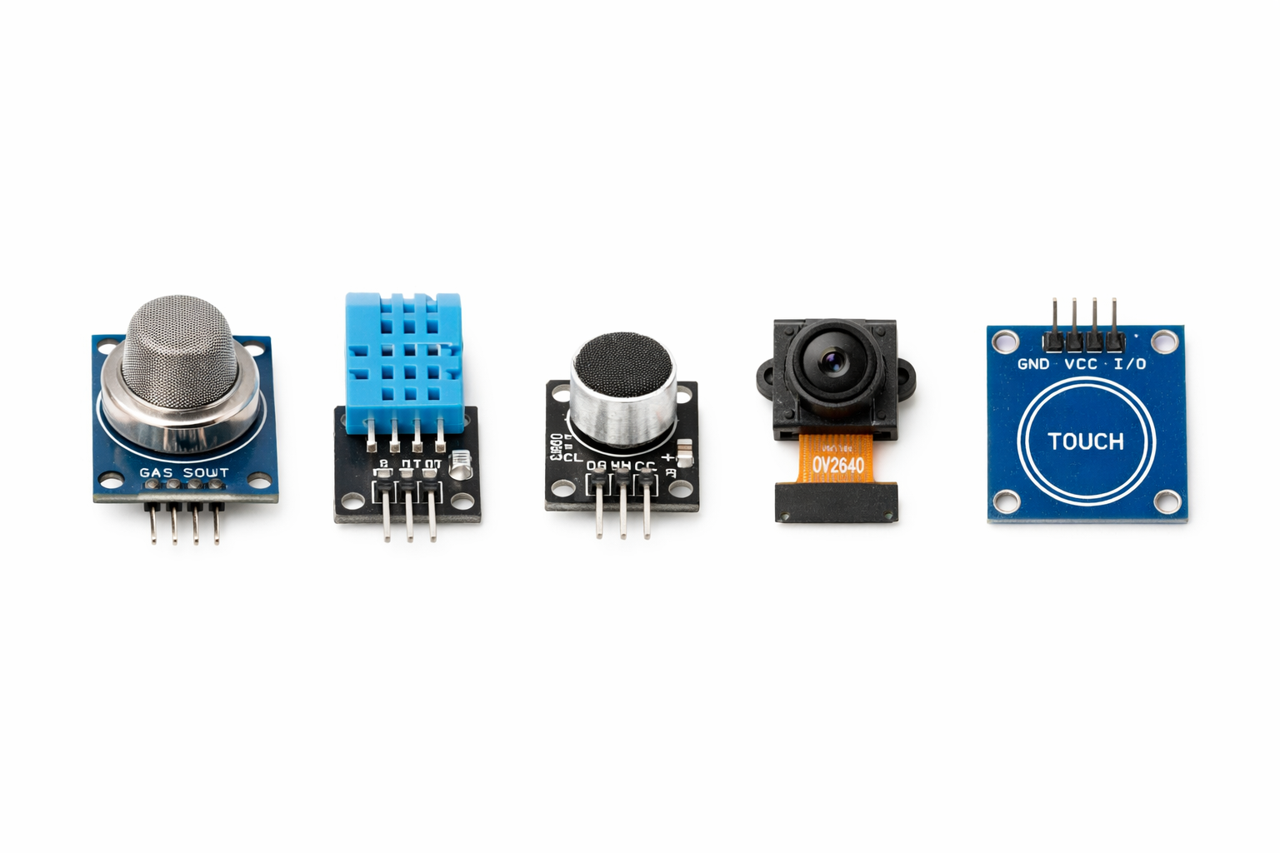
Sensors & Actuators
• Sensors-Gas sensor, temperature and humidity sensor, microphone, camera, touch sensor
• bobbing action, waddling motion
• Autonomous control

Slide 16
Feasibility & Risks
• Is it Buildable?
• Designed within typical undergraduate project cost and lab constraints
• Risks & mitigation
The system is designed to fail safely by stopping motion and notifying the caregiver
Notes:
Technical Feasibility
Low-DOF bipedal design enables manageable control
Event-driven sensing reduces computational load
FSM-based behavior control ensures predictability
Modular subsystems allow incremental integration
Reviewer signal: You understand why this is buildable, not just that it is.
Cost / Resources
Commodity sensors (gas, temp, humidity, ToF, IMU)
Servo-based actuation for legs and eyes
Single-board computer + microcontroller architecture
Fabrication using 3D printing / laser cutting
Statement to keep:
Designed within typical undergraduate project cost and lab constraints.
Risks & Mitigation
Risk: Bipedal balance instability
Mitigation: Low walking speed, wide stance, passive safety stop
Risk: Sensor false positives
Mitigation: Threshold tuning and multi-sensor confirmation
Risk: Overcomplex behavior logic
Mitigation: Finite State Machine with limited states
Risk: User discomfort or confusion
Mitigation: Predictable motions and neutral failure behavior
This shows engineering maturity, not fear.

Slide 17
Proof of Concept Plan
• What will be demonstrated
• Simulation/mock-up plan
• Expected output

Slide 18
Innovation & Sustainability
• Novelty
• Multi-domain application
• Sustainability aspects
Notes:
1. Novelty Better options:
Innovative approach
Unique design concept
First-of-its-kind solution (if justified)
Distinctive innovation
2. Multi-domain application This is solid but a bit academic. Friendlier options:
Applications across multiple domains
Cross-domain usability
Versatile use cases
Adaptable to multiple sectors
3. Sustainability aspects You can make this more concrete:
Sustainable design considerations
Energy-efficient and eco-conscious
Environmentally responsible design
Long-term sustainability benefits

Slide 19
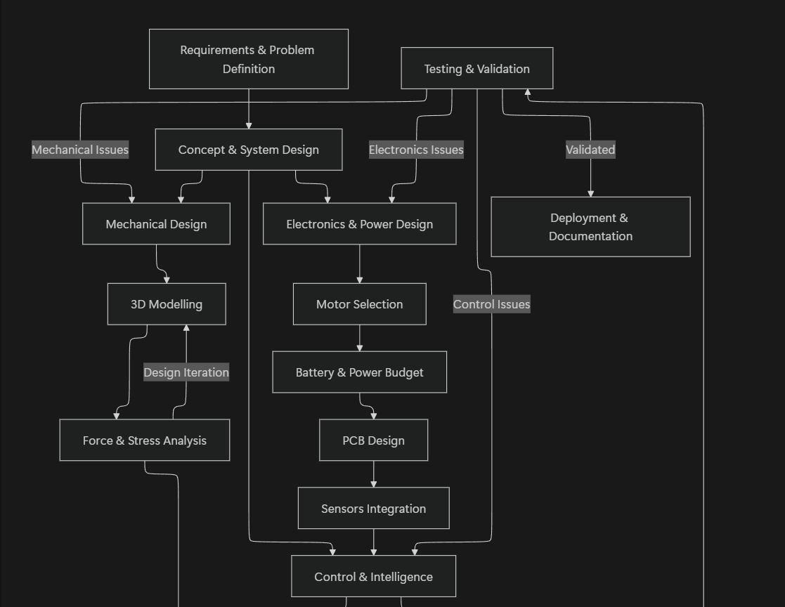
System Architecture

Slide 20
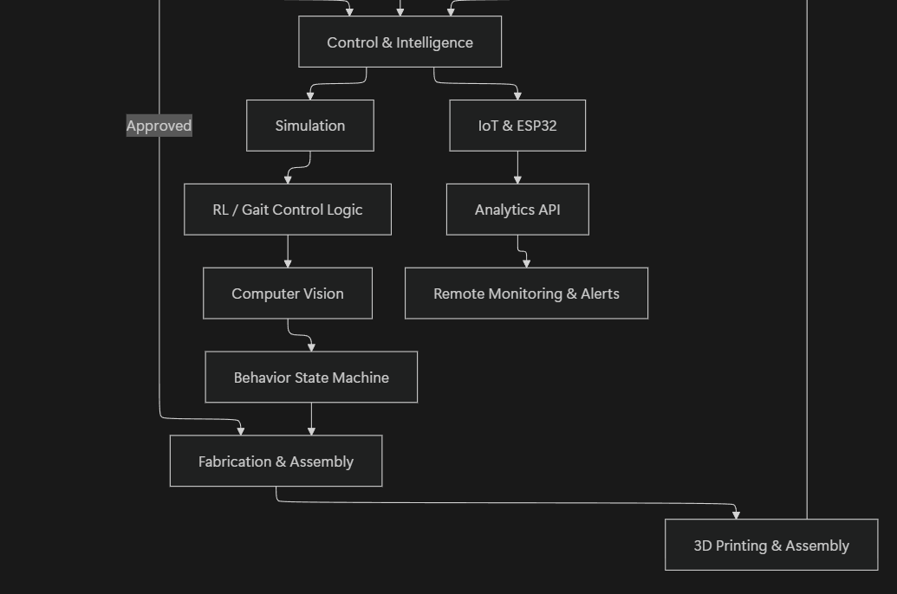
System Architecture

Slide 21
Phase-2 Roadmap
• Next steps
• Hardware build plan
• Testing & validation
Notes:
Plan for Paper

Slide 22
Expected Outcomes
• Technical outcomes
• Skills/tools learned

Slide 23
Conclusion
• Problem–solution Overview
• Readiness for next phase
Our goal is not to replace pets—but to make companionship more accessible.
Notes:
Problem–Solution Summary
Identified lack of affordable, emotionally engaging robots
Proposed a simple, pet-like robot using minimal movements
Balanced interaction, cost, and sustainability
Readiness for Next Phase
Design validated
Concept scalable
Ready for:
Further testing
Feature expansion
User studies or prototyping

Slide 24
References
Mini: A New Social Robot for the Elderly
Robot Leg Design: A Constructive Framework
Biomimetic soft-legged robotic locomotion, interactions and transitions in terrestrial, aquatic and multiple environments
BirdBot achieves energy-efficient gait with minimal control using avian-inspired leg clutching

Slide 25
Q & A
Thank You

